Slide 1
GFF HOA Open Meeting
January 29, 2025

Slide 2
Board Positions - Current
President Scott Reed (interim)
Treasurer Nicole Faxon
Secretary Vanessa Santosuosso
Landscaping Stan MacDonald
Architectural Review Peter Murphy
Scott Reed
At Large John Bergeron
Carolyn Dyrvik
CBZ Law Attorney John Bisson

Slide 3
Agenda
Highlighted Accomplishments
Solar Policy
Fence Policy
Tree Pruning Issue with Town of Bedford
Bridge Repair Update
GFF HOA Shared Drive Filing System (ARB Tracker, Addresses, Legal Opinions)
2024 Budget vs. Actual Review and 2025 Budget
2024 Budget vs. Actual – Operating
2024 Budget vs. Actual – Reserve
2024 Year-end Balance Sheet
2024 Budget vs. Actual Expenses & 2025 Budget
Landscaping/Common Area Improvement Discussion
Landscaping Projects Inclusive Morin’s Contract - 2024
Additional Landscaping Projects - 2024
Landscaping Projects Under Consideration 2025
Architectural Review Board – 2024 Applications/Decisions
Description of Board of Director Positions

Slide 4
Highlighted Accomplishments 2024
Solar Policy
Fence Policy
Tree Pruning Issue Brought forth by Town of Bedford, NH
Bridge Repair Update
GFF HOA Shared Drive Filing System (ARB Tracker, Addresses, Legal Opinions)

Slide 5
2024 Budget vs. Actual - Operating

Slide 6
2024 Budget vs Actual - Reserves

Slide 7
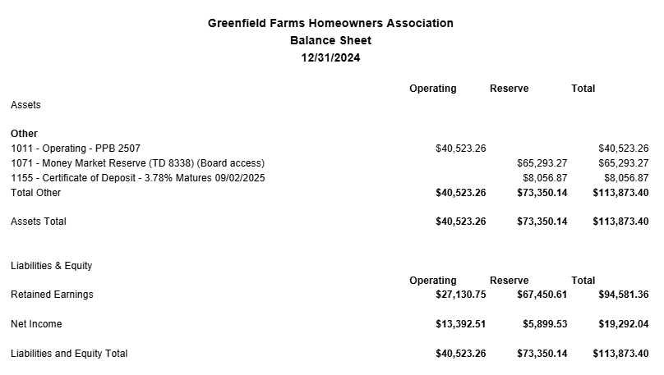
2024 Year-end Balance Sheet

Slide 8
2024 Budget vs Actual and 2025 Budget

Slide 9
Landscaping Projects 2024 – Inclusive of Morin’s Annual Contract
Plant beds located at corners intersections of Greenfield Parkway kept weed free and well maintained
Established definition between plant beds and the native woods behind beds preventing wild native growth from encroaching into manicured areas
Common area turf abutting power lines kept clean and well maintained

Slide 10
Adhoc Landscaping Projects (not included in Morin’s annual contract)
Turf Install on Greenfield Parkway Center Median Island - $5985
Remove existing small shrubs and daylilies and ornamental grasses
Add compost and soil and raise to grade
Install Metro Blend grass seed (rye/bluegrass mix)
Apply starter fertilizer
Pruning/Tree Limbing Up/ Tree Removal - $5980
Response to Town Letter regarding Plowing and scheduled maintenance of ornamental fruit trees
Create play area for children corner Baileys / Adams Green - $2890
Clean Entire Woods Area Located Corner of Baileys/Adams Green
Blow out leaves, sticks loose debris around large granite boulders
Cut down flush to ground all saplings/mini trees with < 4” caliper
Create plant bed edges Wallace Rd. / GFParkway - $2565
Create plant bed edges around large viburnum and burning bush shrubs located along white vinyl fence. Smooth out / regrade dig areas resulting from last year’s paving project. Remove spirea juniper ground cover and loam / seed as needed.

Slide 11
Landscaping projects under consideration for 2025
Replace several damaged / fallen trees along Greenfield Parkway and Winding Rd. that have broken leader branches/ main trunk
Expand site lines by clearing small trees / brush near GFP and Wallace Rd.
Upgrade plant material on traffic island beds located on Liberty Hill Rd.
Improve native woods area on Adams Green by clearing out non-essential low growth brush
Regrade, add loam/seed to section across from 9 Barnside Dr.
Island Improvement at corner of Liberty Hill Rd./ Baileys Green
Seasonal flowers (drought tolerant perennials and fall mums) at entrances
ADDITIONAL SUGGESTIONS WELCOMED FROM HOMEOWNERS

Slide 12
Architectural Review Board – Applications 2024
55 applications; 50 approved
Tree Removal 16
Roof Replacement 9
Driveway, Walkway, Pathway 8
Shed 5
Deck (New, repair, expansion) 5
Other (Firepit, Playset, Turf) 3
Exterior Doors/Window Siding 1
Swim Spa 1
Garage Addition 1
Patio Shingle Roof Addition 1

Slide 13
Board of Director (BOD) Elections
Three (3) Vacancies
Two (2) Year Term (Jan 2025 – Jan 2027)
Elected to the Greenfield Farms BOD, not specific office
Directors and Committee members are elected/volunteered/assigned by the BOD at the first BOD meeting following Annual Meeting
Candidates must be nominated
Elections held if there are more candidates than vacancies
Vote of confidence/acceptance, if number of candidates are equal or less than the number of vacancies

Slide 14
Description of Board of Director Positions
President
Schedule, coordinate and oversee all monthly Board of Director meetings. Serve as primary point of contact for all external concerns/meetings (e.g., Town of Bedford, PSNH, Pennichuck Water, CBZ Law, etc.). Call special meetings as necessary and preside over ARB hearings/disputes.
Secretary
Take Minutes at Monthly Board of Director Meetings and upload approved Meeting Minutes to Google Drive for historical reference. Prepare Mailings for Annual Meetings and work with Printing Company to ensure timely delivery to homeowners.
Treasurer
Liaison between BOD and Evergreen Mgmt Company. Review Financials from Evergreen, including accounts receivable, reconcile cash reserve bank accounts, make deposits, submit cash reserves figures, submit, review, and approve invoices for Evergreen to pay from Operating account. Prepare annual budget . Work to collect delinquent accounts.
Landscaping
Oversee contract with landscaping contractor(s) to ensure common areas and entrances of neighborhood are well maintained and look pristine and costs remain within budget. Review work performed by landscapers on a regular basis and anticipate future work needed. Obtain proposal bids from landscapers.
Architectural Review
Review and decision requests submitted for home/property improvements. Uphold GFF Declaration Articles and Bylaws that govern the HOA in all matters such as pools, fences, signage on properties, play structures and more. New precedent applications are reviewed and voted upon my entire board.

Slide 15
Open Discussion

